Slide 1
Project Time Management (Cont.)
Project Management
Year 4

Slide 2
Fast Tracking
Fast-Tracking: commencing phases (or activities) before their logical predecessor is completed.
Increases Risk
Can result in having to re-work elements of the project, which may result in a net gain of zero time.
Fast Tracking carries many of the risks and trade-offs associated with Crashing.
Fast Tracking will also have costs associated. Analysis can be carried out in a similar manner to Crash Costing.

Slide 3
What-If Scenario Analysis
Can be useful for gaining a better understanding of the project schedule
What if activity B is extended by 3 weeks
What if the start of activity E is delayed by 1 week
Etc.
Significant ‘What If’ questions should be posed (and recorded) as part of Risk Analysis
What-If questions need to be realistic
Year 2000 contingency plan for a factory
Enough Fuel held on site to run electricity generators for 3 months.
Question ‘What if the ESB is not generating again after that time’
It won’t matter….

Slide 4
Resource Levelling
Remember:

Slide 5
Resource Levelling
Resource Levelling involves changing the project program to ensure that
Resources are not over allocated, and only used when available
The logic of the project is maintained
In the ‘Bob & Jim’ example no logic is stated in the Gantt Chart.
One of the limitations of Gantt Charts
So, to level the resources we move tasks to suit resource availability

Slide 6
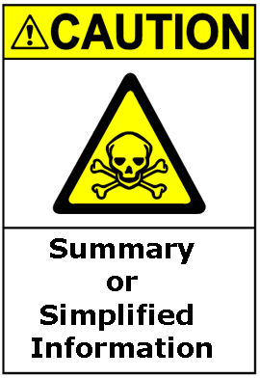
Resource Levelled Gantt Chart
This example is not particularly efficient
Bob is not used on Day 1
There is no indication that Tasks D and F can be moved in this manner. (no network logic)

Slide 7
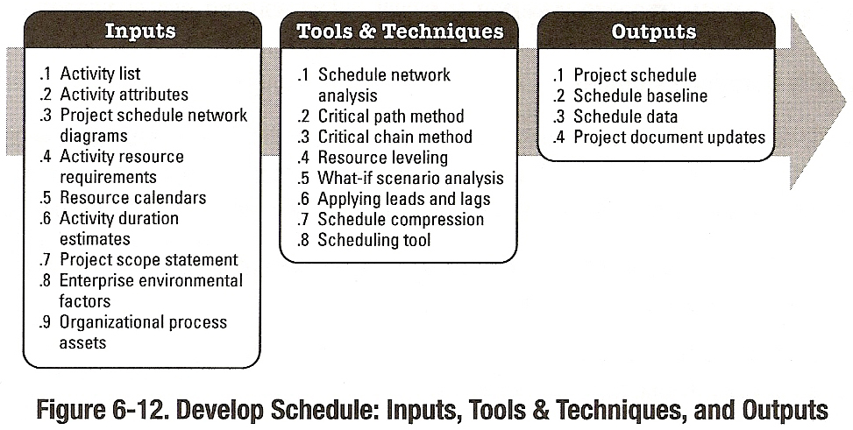
Schedule Development
Part of the Planning Process Group

Slide 8
Schedule Development
Tools & Techniques (cont.)
Project Management Software
Primavera, MS Project, etc.
Applying Calendars
Project Calendars: Identification of working time and non-working time
Resource Calendars: Identification of resource availability (holidays, shift workers, resource utilised elsewhere, etc.)
Adjusting Leads and Lags
Schedule Model
Compilation of Schedule Data and Information used to generate the schedule.
Typically used for reference later on during the project

Slide 9
Schedule Development
Outputs
Project Schedule
Network Diagrams
Bar Charts (Gantt)
Milestone charts
Schedule Model Data
Supporting Data
Schedule Baseline
Resource Requirements
Activity Attributes (Updates)
Project Calendar (Updates)
Requested Changes
Project Management Plan (Updates)
Schedule Management Plan (Updates)

Slide 10
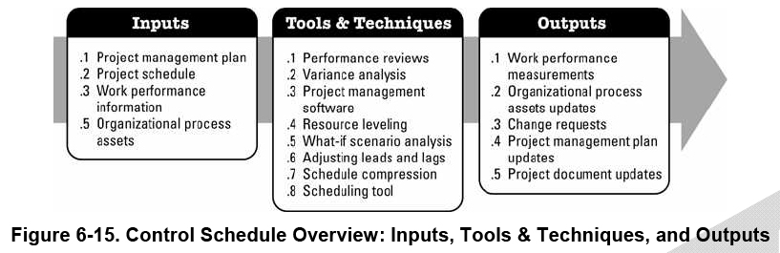
Control Schedule
Part of the Monitoring & Controlling Process Group

Slide 11
Control Schedule
Schedule Control is concerned with
Determining the current status of the project schedule
Influencing the factors that create schedule changes
Determining that the project schedule has changed
Managing the actual changes as they occur

Slide 12
Control Schedule
Inputs
Project Management Plan
Schedule Management Plan is part of overall Project Management Plan
States how the Schedule will be managed and controlled
Version number, circulation, processes, etc.
Project Schedule
Initial Approved Project Schedule
Controlled Updated version of Approved Project Schedule
Used as a yardstick against which project progress and performance is measured

Slide 13
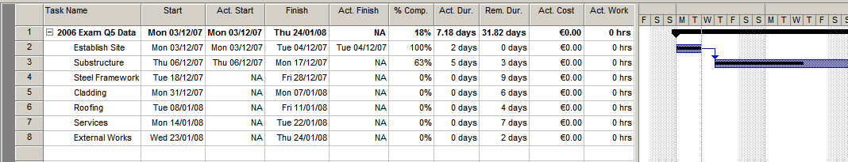
Control Schedule
Inputs
Work Performance Information
Performance Reports
Contain Information on schedule performance
Planned v. Actual start dates, completion dates, milestones, etc. (Ms Project View|Table:Tracking)
Also highlight potential issues before they arise
‘look-aheads’
Organisational Process Assets

Slide 14
Control Schedule
Tools & Techniques
Progress Reports
Information on actual start and finish dates, rates of progress,
Potential issues arising (unforeseen ground conditions)
Earned Value
Schedule Change Control System
Details the processes that need to be undertaken to modify the project schedule.
Tracking Systems, Approvals, etc.
Part of the Integrated Change Control Process

Slide 15
Control Schedule
Tools & Techniques
Performance Measurement
Schedule Variance (SV) and Schedule Performance Index (SPI); used to assess the magnitude of project schedule variations; all part of Earned Value Management System
Project Management Software
MS Project, et al
Variance Analysis
Comparison of target dates with actual and forecast dates
Identification of trends and magnitudes of variances

Slide 16
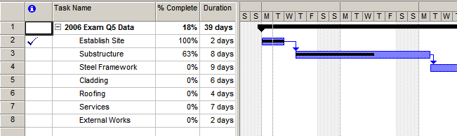
Control Schedule
Tools & Techniques
Schedule Comparison Bar Charts
e.g. MS Project %age completion

Slide 17
Control Schedule
Outputs
Work Performance Measurements
EVMS Information
Organisational Process Assets Updates
Causes of Variances
Corrective Actions chosen and reason for
Lessons Learned
Change Requests
Processed through Integrated Change Control

Slide 18
Control Schedule
Outputs
Project Management Plan Updates
Project Baseline Updates
Cost Baseline Updates
Schedule Management Plan Updates
Project Document Updates
Schedule Data
Project Schedule

Slide 19
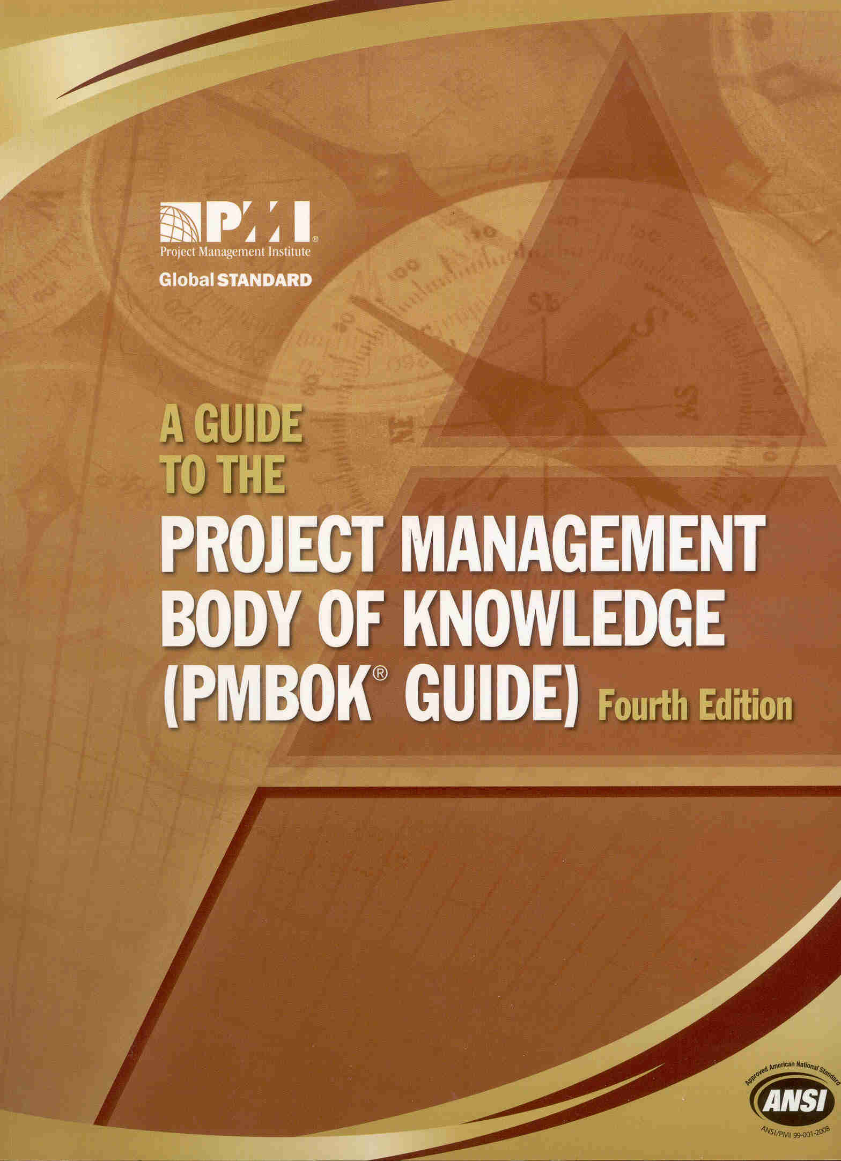
Next Lecture
Reading: ‘A Guide to the Project Management Body of Knowledge’ Chapter 7
Cost Estimating
Cost Budgeting
Cost Control

